Slide 1
Chapter 19 – Social Network Analytics
Data Mining for Business Analytics in R
Shmueli, Bruce, Yahav, Patel & Lichtendahl

Slide 2


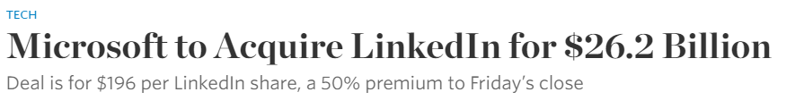
2000’s: The advent of businesses based on social network data
Early movers: Friendster, Myspace
Later: Facebook, LinkedIn, Twitter, Tumblr, Instagram, Yelp, TripAdvisor, …
Common element: Data on their network of users is the main business asset

Slide 3
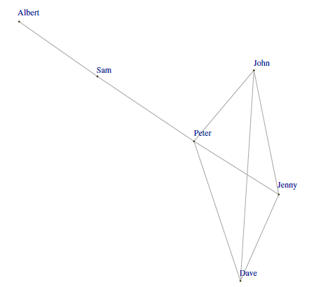
Hypothetical LinkedIn Network
Connections are undirected
library(igraph)
# define links in data
edges <- rbind(
c("Dave", "Jenny"), c("Peter", "Jenny"), c("John", "Jenny"),
c("Dave", "Peter"), c("Dave", "John"), c("Peter", "Sam"),
c("Sam", "Albert"), c("Peter", "John")
)
# generate and plot graph
# set argument directed = FALSE in graph.edgelist() to plot an undirected graph.
g <- graph.edgelist(edges, directed = FALSE)
plot(g, vertex.size = 1, vertex.label.dist = 0.5)

Slide 4
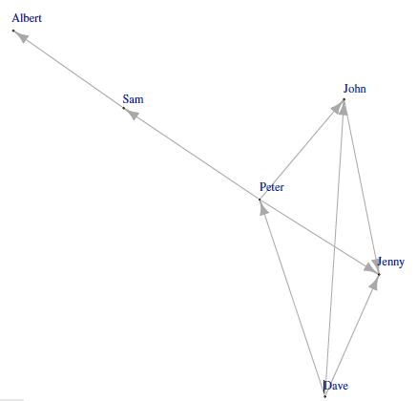
Connections are directed (e.g. following someone in Twitter)
# set argument directed = TRUE in graph.edgelist() to plot an undirected graph.
g <- graph.edgelist(edges, directed = TRUE)
plot(g, vertex.size = 1, vertex.label.dist = 0.5)

Slide 5
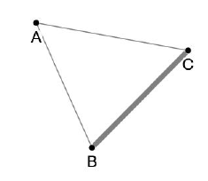
Edge weight (thickness) reflects strength of relationship (number of communications, value or number of transactions, etc.)

Slide 6
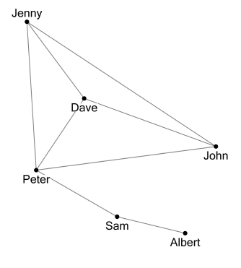
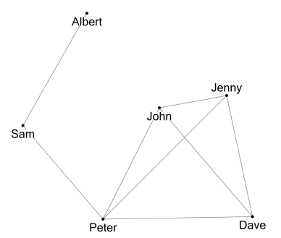
x-y coordinates are not meaningful – these two graphs convey the same information:
=

Slide 7
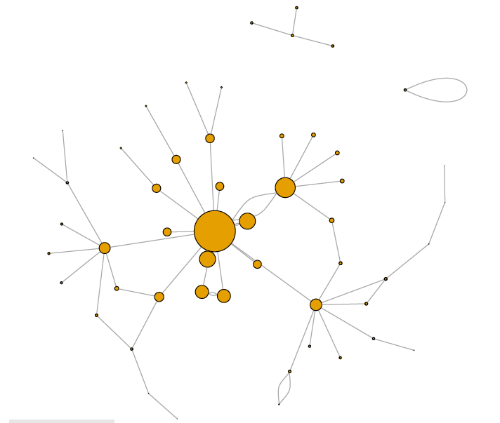
Central and important entities emerge visually in this law enforcement graph of a drug laundry network in San Antonio, TX
Code to read in data to use for drawing the graph:
library(igraph)
drug.df <- read.csv("Drug.csv")
# convert edges to edge list matrix
edges <- as.matrix(drug.df[, c(1,2)])
g <- graph.edgelist(edges,directed=FALSE)
# plot graph
# nodes' size is proportional to their eigenvector centrality
plot(g, vertex.label = NA, vertex.size = eigen_centrality(g)$vector * 20)
A metric of node importance

Slide 8
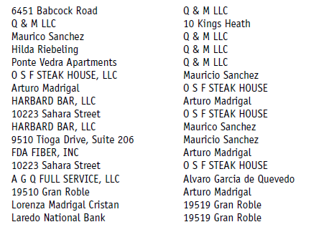
Rows in the edge list for the drug laundry network denote the nodes at either end of each connection (edge)

Slide 9

Principles of graph layout:
Every node should be visible
For every node, you should be able to count its degree
For every link, you should be able to follow it from source to destination
Clusters and outliers should be identifiable

Slide 10
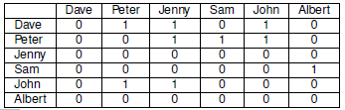
Adjacency list and matrix
Adjacency list, first few rows, Twitter graph
Adjacency matrix, Twitter graph
Origin
Destination
Dave | Peter
Dave | Jenny
Dave | John
Peter | Jenny
Peter | Sam

Slide 11
Terms
Edge weight: strength of relationship
Path (and path length): route from one node to another
Connected network: each node has a path to all others
Clique: each node directly connected by single edge to each other
Singleton: unconnected node

Slide 12
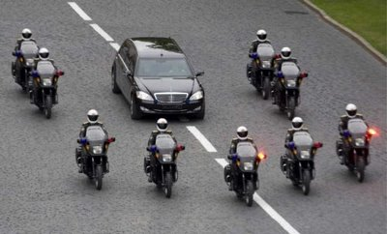
Node Metrics: How central/important is a node?
Degree: number of connections to a node
Closeness: average path length to other nodes
Betweenness: extent to which a node is on the shortest path between other nodes
Eigenvector centrality: links to other highly connected nodes are weighted more, ranges from 0 to 1
Measuring centrality; g is the graph previously calculated:
Egocentric network: The network around a single node
> degree(g)
Dave Jenny Peter John Sam Albert
3 3 4 3 2 1
> betweenness(g)
Dave Jenny Peter John Sam Albert
0 0 2 0 2 0
> closeness(g)
Dave Jenny Peter John Sam Albert
0.12500000 0.03333333 0.09090909 0.04000000 0.04000000 0.03333333
> eigen_centrality(g)
$vector
Dave Jenny Peter John Sam Albert
0.9119867 0.9119867 1.0000000 0.9119867 0.3605471 0.1164367

Slide 13
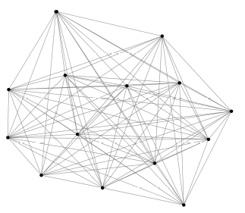
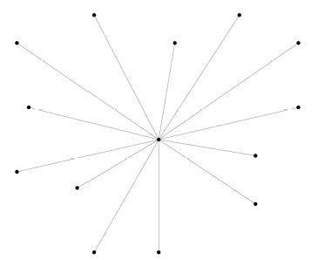
Network metrics: Describing the network as a whole
Degree distribution: Distribution of # of connections per node
Density: Ratio of # of edges to maximum possible # of edges
Dense network
Sparse network

Slide 14

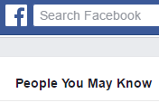
Link Prediction: Predicting the next link to form in a network
For each node, score similarity to all other nodes
Traditional predictive model variables could be used (e.g. demographic info) to calculate similarity [see nearest-neighbor methods]
Network metrics (shortest path, etc.) can also be used
The unlinked pair with highest similarity score is predicted next link

Slide 15
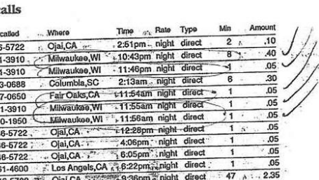
Similar methods can be used in entity resolution (is “x” the same person as “y”)?
A new customer orders online: is the person already in the customer database?
A cell phone number is linked to known terrorists: is its owner the same person as a suspect known to a partner intelligence service?

Slide 16


Collecting Social Data via public API’s
TwitterR
RFacebook
See code in Tables 19.11 and 19.12

